Slide 1
Third Grade Back to School Night 9/3/2015

Slide 2
Items of Note
Question “Parking Lot”
Note to Child

Slide 3
Introductions
Christian Buzzerd – Classroom Teacher, Team Lead
Katherine Russell – Classroom Teacher
Jessica Metz– Classroom Teacher
Lauren Rifkin – Teacher of Record
Diana McGowan – Special Educator
Angela Lovern – Special Educator
Erin Dorn – ESOL Teacher
Colleen Taweel - Paraeducator
Notes:
-Give quick introduction of yourself, teaching background

Slide 4
Communication
Agenda Books
Friday Folders
Interim Reports
Report Cards
Conferences
Notes
Email/Phone
Website

Slide 5
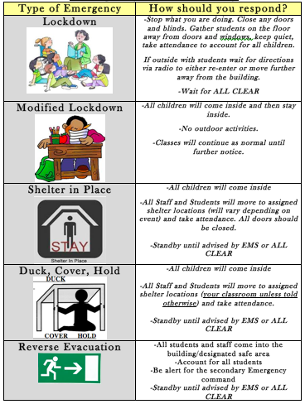
Emergency Procedures

Slide 6
PBIS

Slide 7
Daily Schedule
8:45-9:00 Arrival/Morning Work
9:00-10:00 Content (Science, Social Studies, Health)
10:00-11:00 Related Arts (P.E., Art, Technology, Music, Media)
11:00-12:30 Language Arts
12:30-1:30 Recess/Lunch
1:30-2:45 Math
2:45 – 3:05 DEAR
3:05-3:15 Stack and Pack
3:15-3:25 Dismissal

Slide 8
Language Arts
4 heterogeneous classes – smaller class size, more one-on-one instruction
Fiction – realistic, fantasy, folktales, poetry
Nonfiction – informational text, biographies, historical texts
Writing – personal narrative, opinion, letter, realistic fiction, folktale, biography, author study, research
Spelling/Vocabulary
Cursive

Slide 9
Spelling/Vocabulary
Word lists are organized through meaningful Greek and Latin roots or patterns
Help students learn meanings of new words independently and make connections.
90% of English words of two or more syllables are of Greek or Latin origin
Assessments
First Week – Spelling
Second Week – Vocabulary and Meaning

Slide 10
Spelling/Vocabulary
tractor
attract
trac/tract
traction
extract
contract
subtract
pull, draw, drag

Slide 11
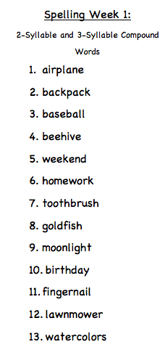

Slide 12
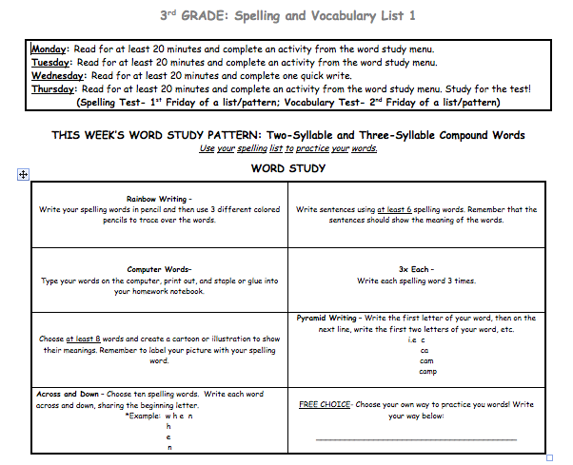

Slide 13
Math
Focus on conceptual understanding and problem solving
Homework most nights
Math Facts
CC Review
PLEASE BE PATIENT!

Slide 14
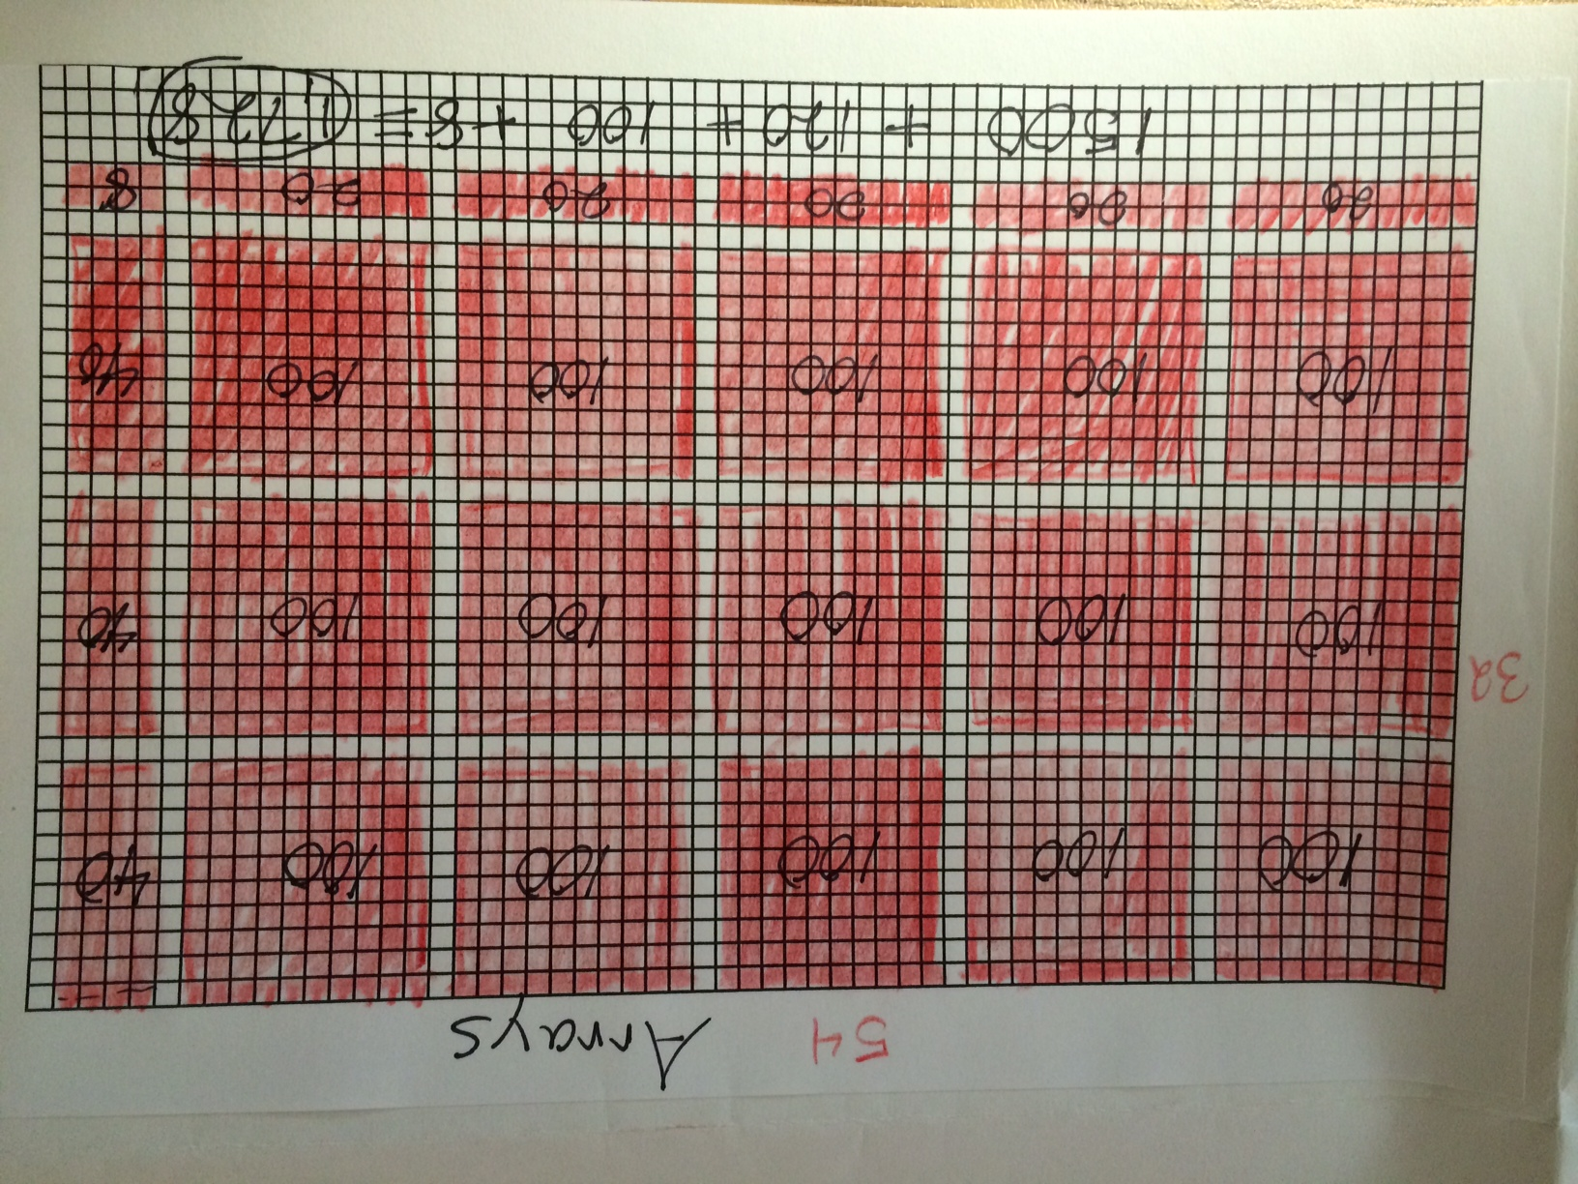
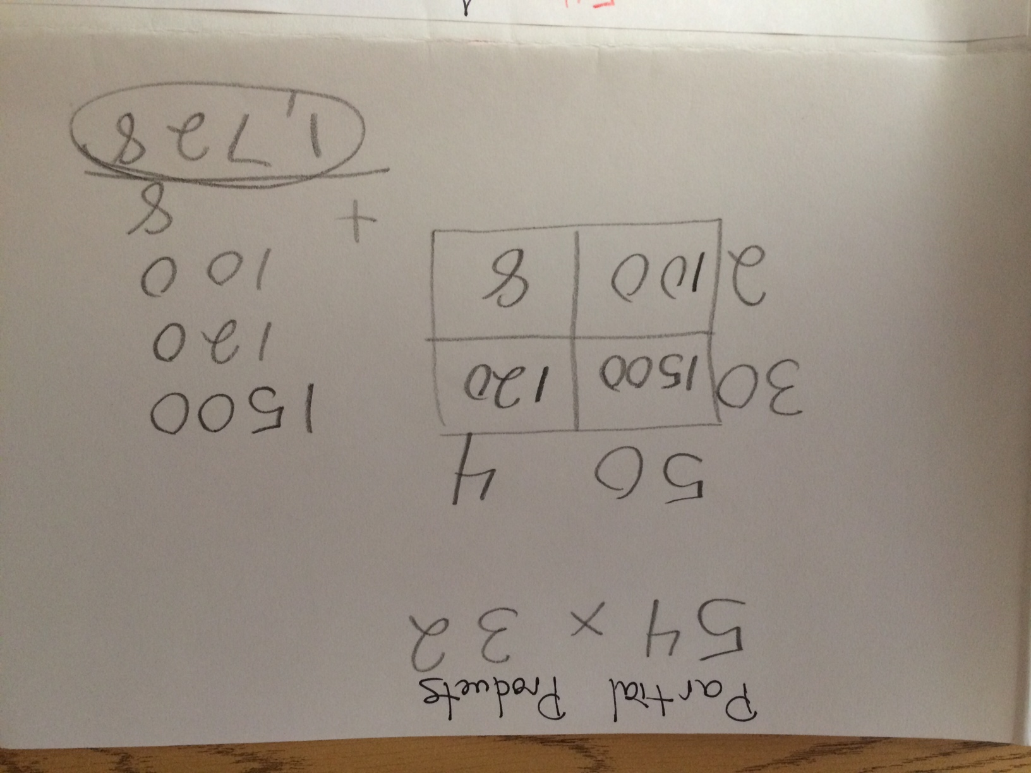
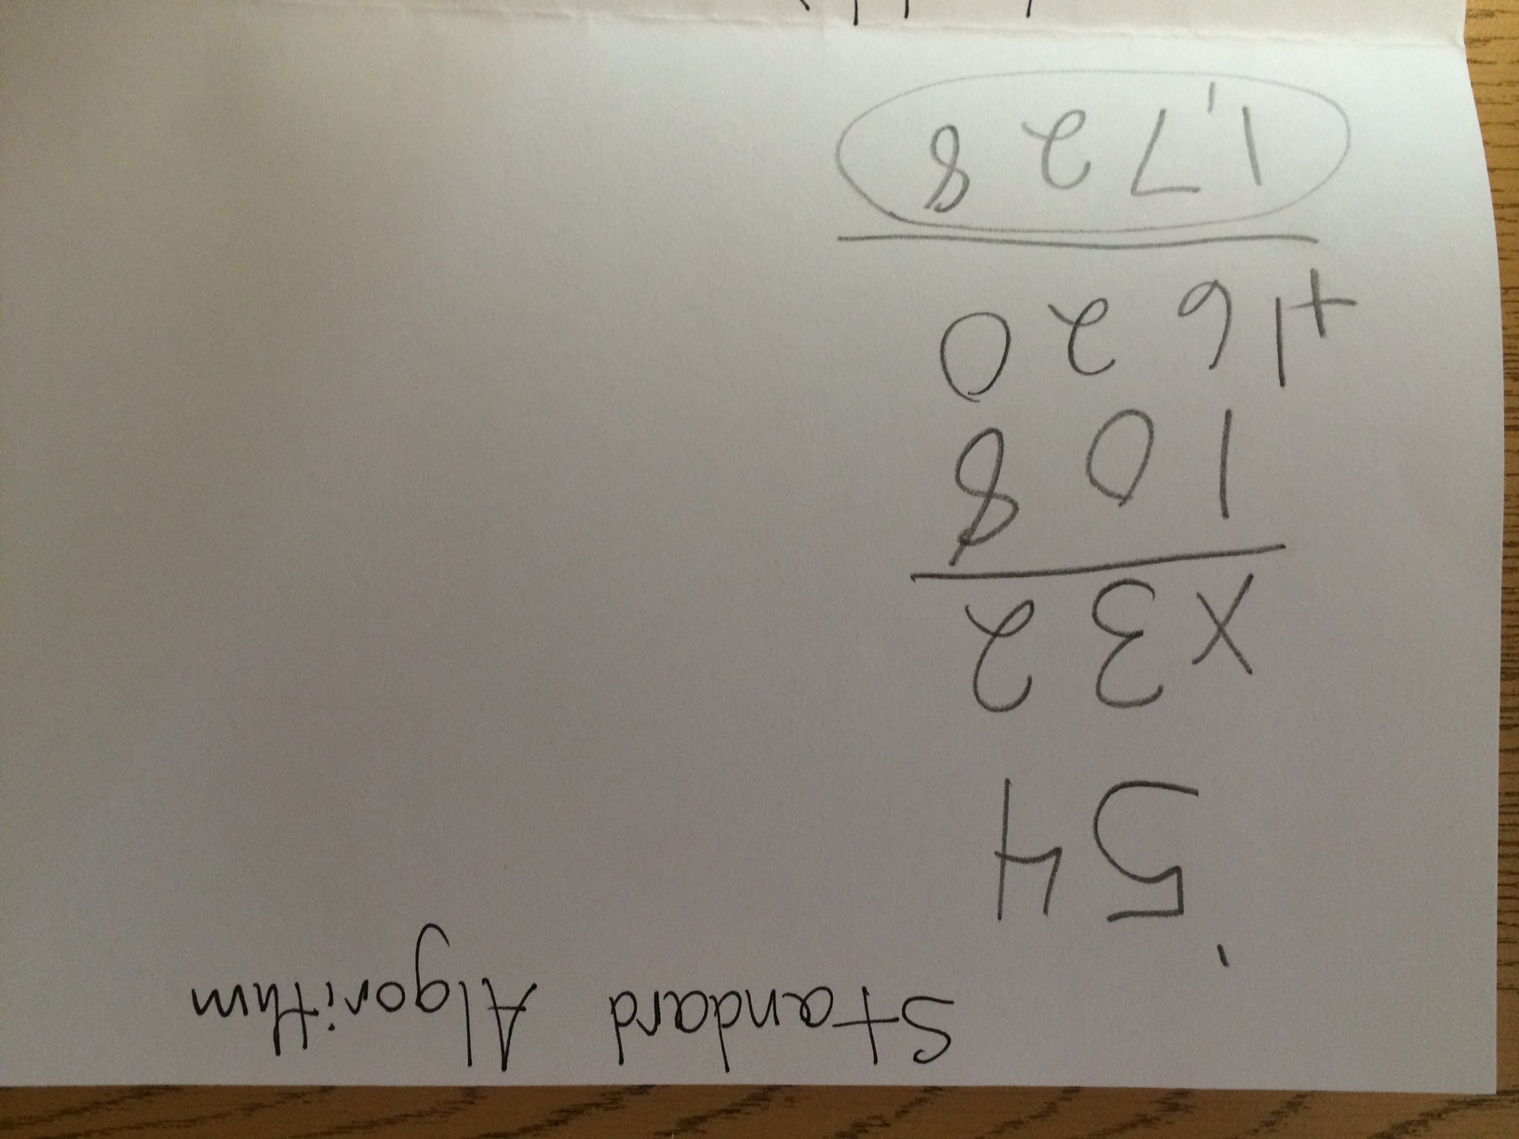
54 X 32

Slide 15
Math
Place Value
Addition and Subtraction Concepts, Methods, and Strategies
Multiplication and Division Concepts, Methods, and Strategies
Fraction Concepts and Computation
Plane Geometry
Standard and Metric Measurement
Time Measurement and Computation
Multi-Step Problem Solving

Slide 16
Science
3rd Grade curriculum based on Next Generation Science Standards (NGSS) focuses on students applying knowledge of both science and engineering.
Quarter 1 – Weather and Climate
Quarter 2 – Forces and Interactions
Quarter 3 – Plant and Animal Survival
Quarter 4 – Life Cycles and Traits

Slide 17
Social Studies
New curriculum based on the College, Career, and Civic Life (C3)Framework for Social Studies focuses on engaging students with multiple resources and real-world connections.
Quarter 1 – Changing Communities
History of Ellicott City and changing technologies
Quarter 2 – Mapping Our World
Physical and cultural geography
Quarter 3 – Money Matters
Decision making and economics
Quarter 4 – Citizen and the Community
Civics and community leaders

Slide 18
MAP Measures of Academic Progress
We are using the MAP Assessments in Reading and Mathematics.
MAP is:
Computer-adaptive
Administered in Fall, Winter (selected students), and Spring
Created by Northwest Evaluation Association (NWEA)

Slide 19
MAP Measures of Academic Progress
Measures student growth, both during the school year and across multiple school years.
Determines instructional strengths and needs, in conjunction with other measures.
Provides academic performance information for parents.

Slide 20
PARCC
2-3 weeks in mid April
Testing for both Language Arts and Math
Performance Based items ask students to demonstrate conceptual knowledge and problem solving skills.
Computer Based, using multiple means of showing answers, as well as text, audio, and video.

Slide 21
tresthirdgrade.weebly.com

Slide 22
https://twitter.com/hcpss_tres

